Slide 1

GREETINGS!
July 7, 2023
Title Page Option

Slide 2
Objective
To inspire and help empower the leadership of RLI-MA with ideas, resources, and tools for continual and increasing success.

Slide 3
Una Martone
2006 Rotary Club of Harrisburg
2009 Robert D. Hanson Award for Excellence
2012/13 Club President
2013 RLI Part 1
2013 - 2015 District 7390 Membership Committee, Installation Committee, District Conference Committee, Assistant Governor, DGND, Foundation Committee, Grants Committee
2015/16 DGN
2016/17 DGE
2017/18 District Governor
2018 – Present RLI Facilitator
2018 – Present Facilitator, Mid Atlantic PETS
2018 – 2023 Chair, Four Way Test Speech Contest
2018 – 2021 District Trainer
2020 Training Leader, Rotary International
2020 – Present Training Leader Rotary Zones 28 & 32
2021 Training Leader, Rotary International
2023 – 24 Executive Trainer, Mid Atlantic PETS
2023 Marketing Committee, Rotary International Convention, Melbourne, Australia

Slide 4
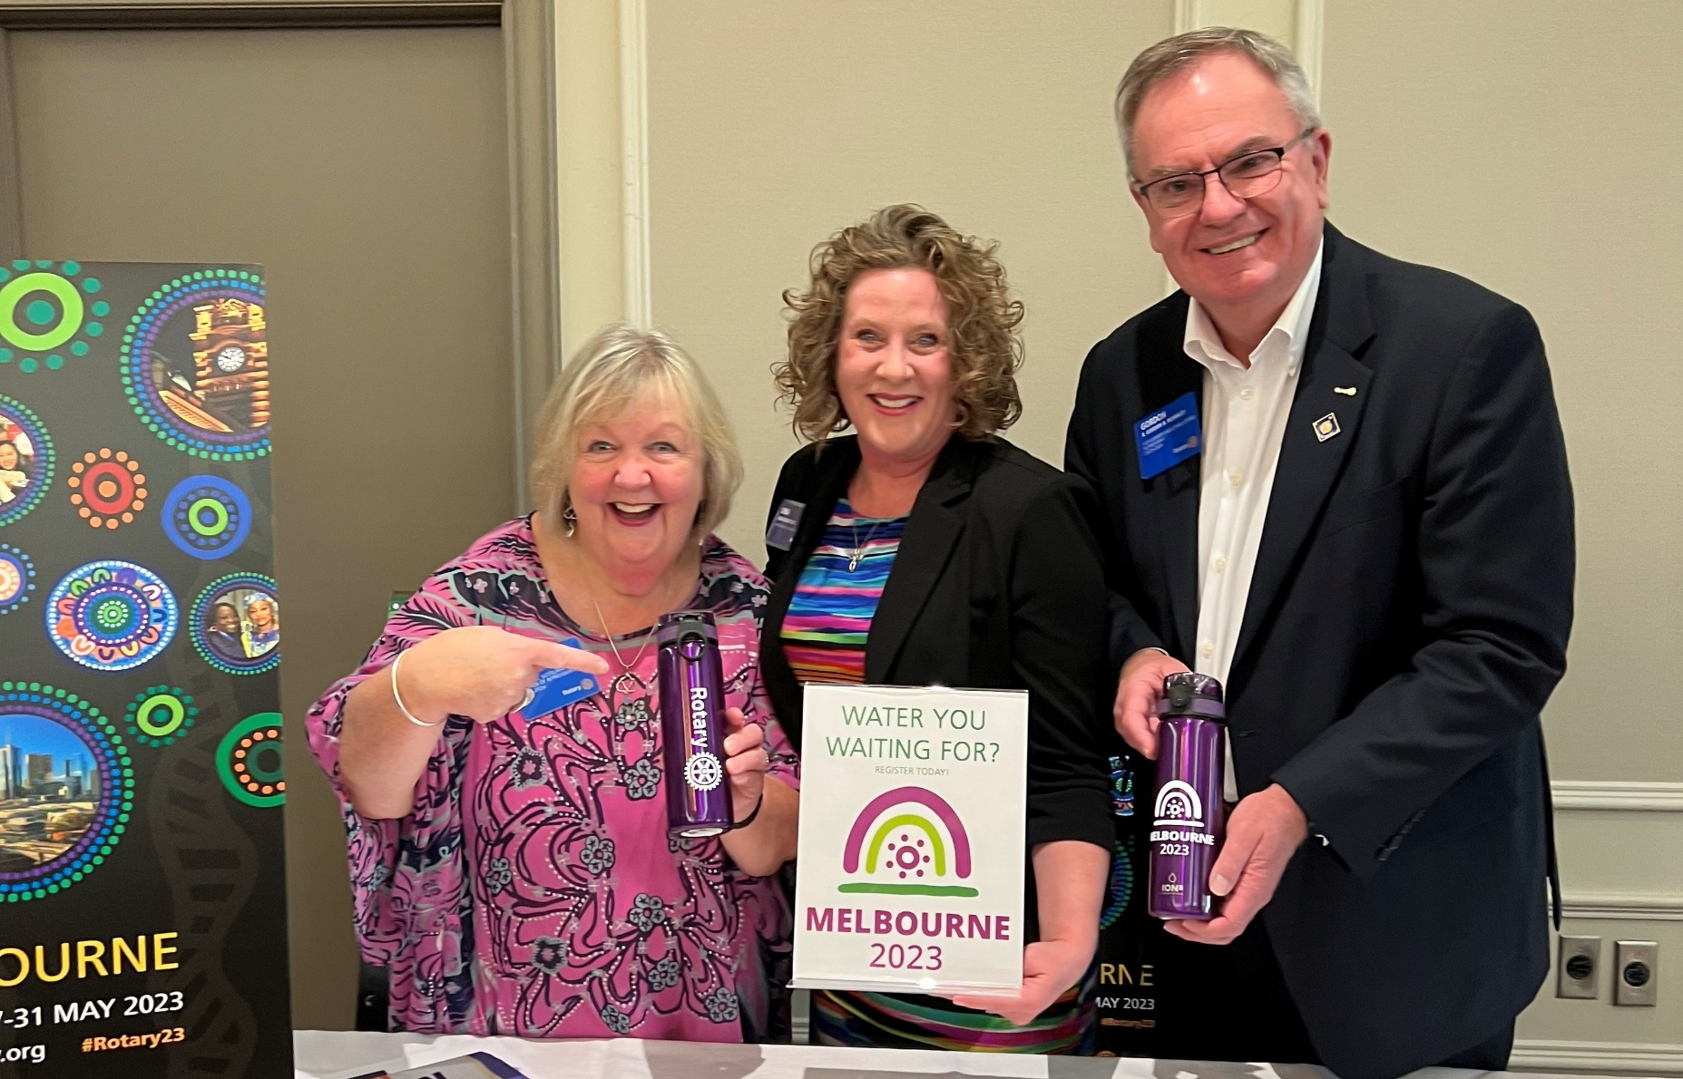
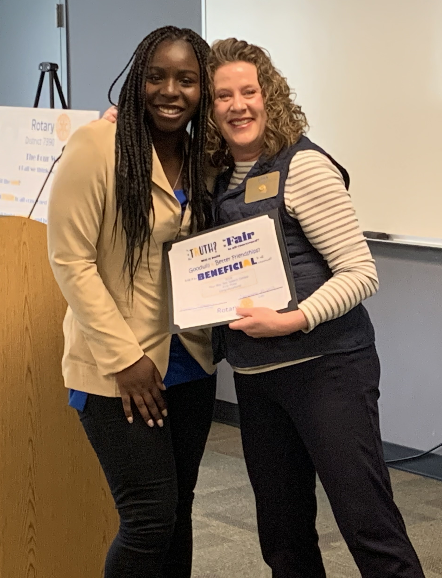
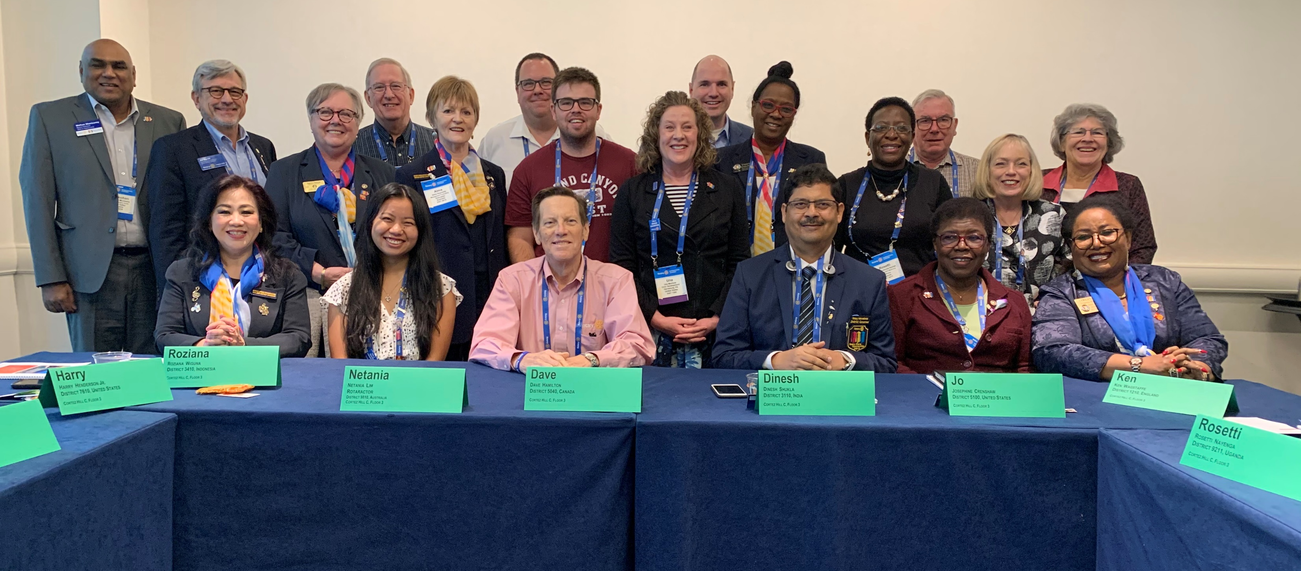
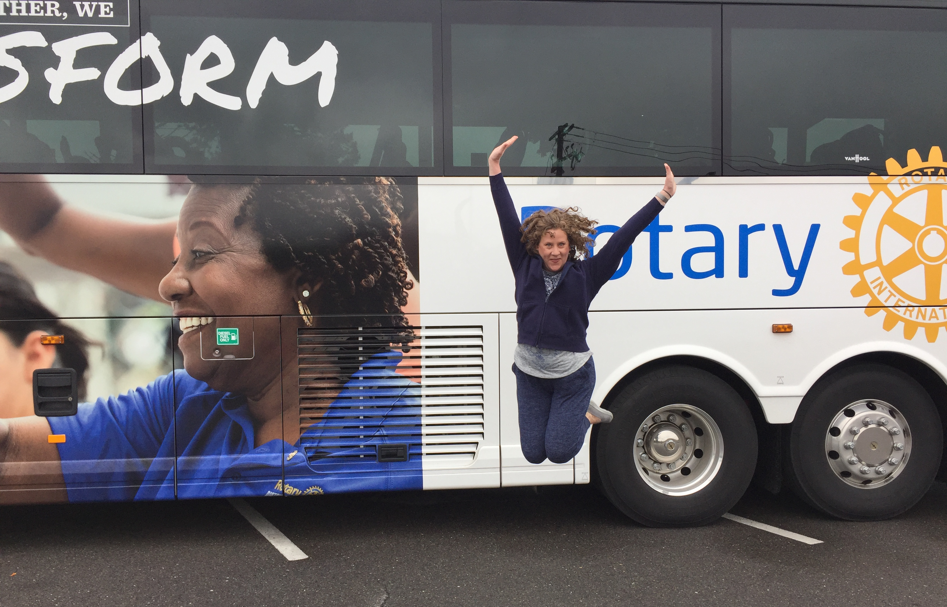
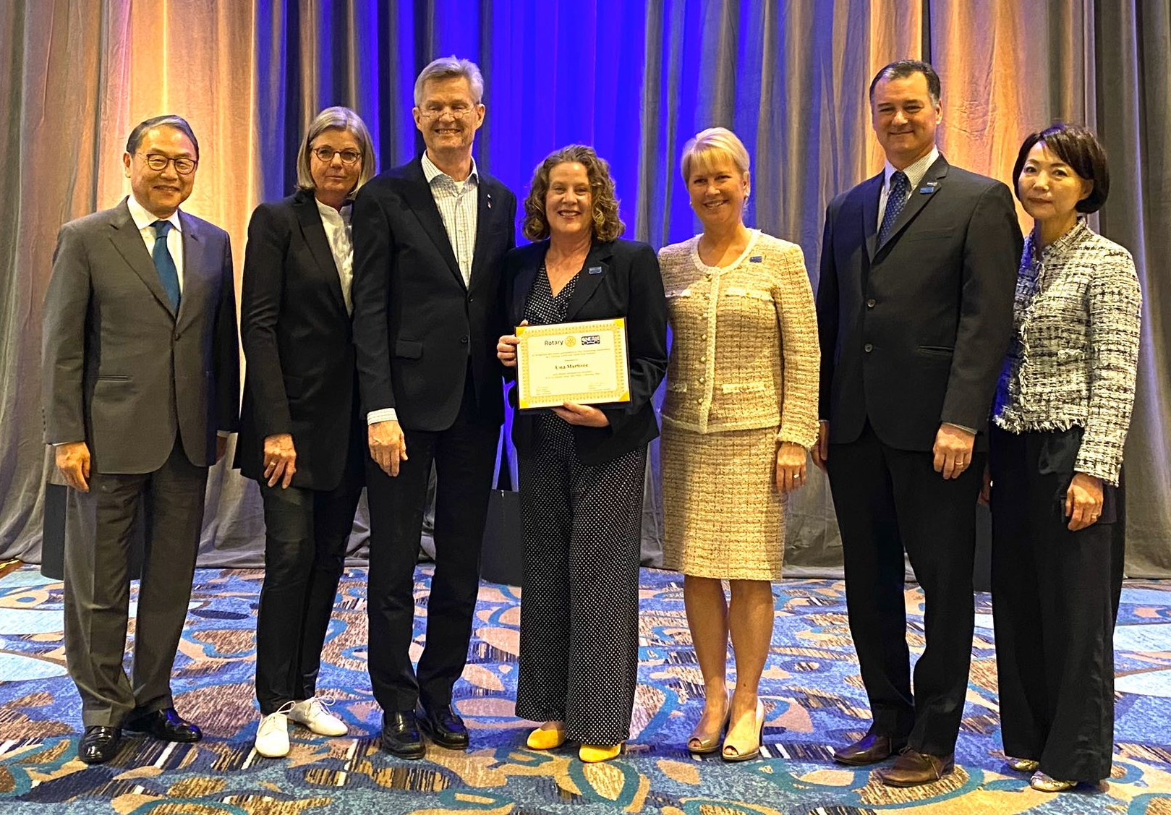
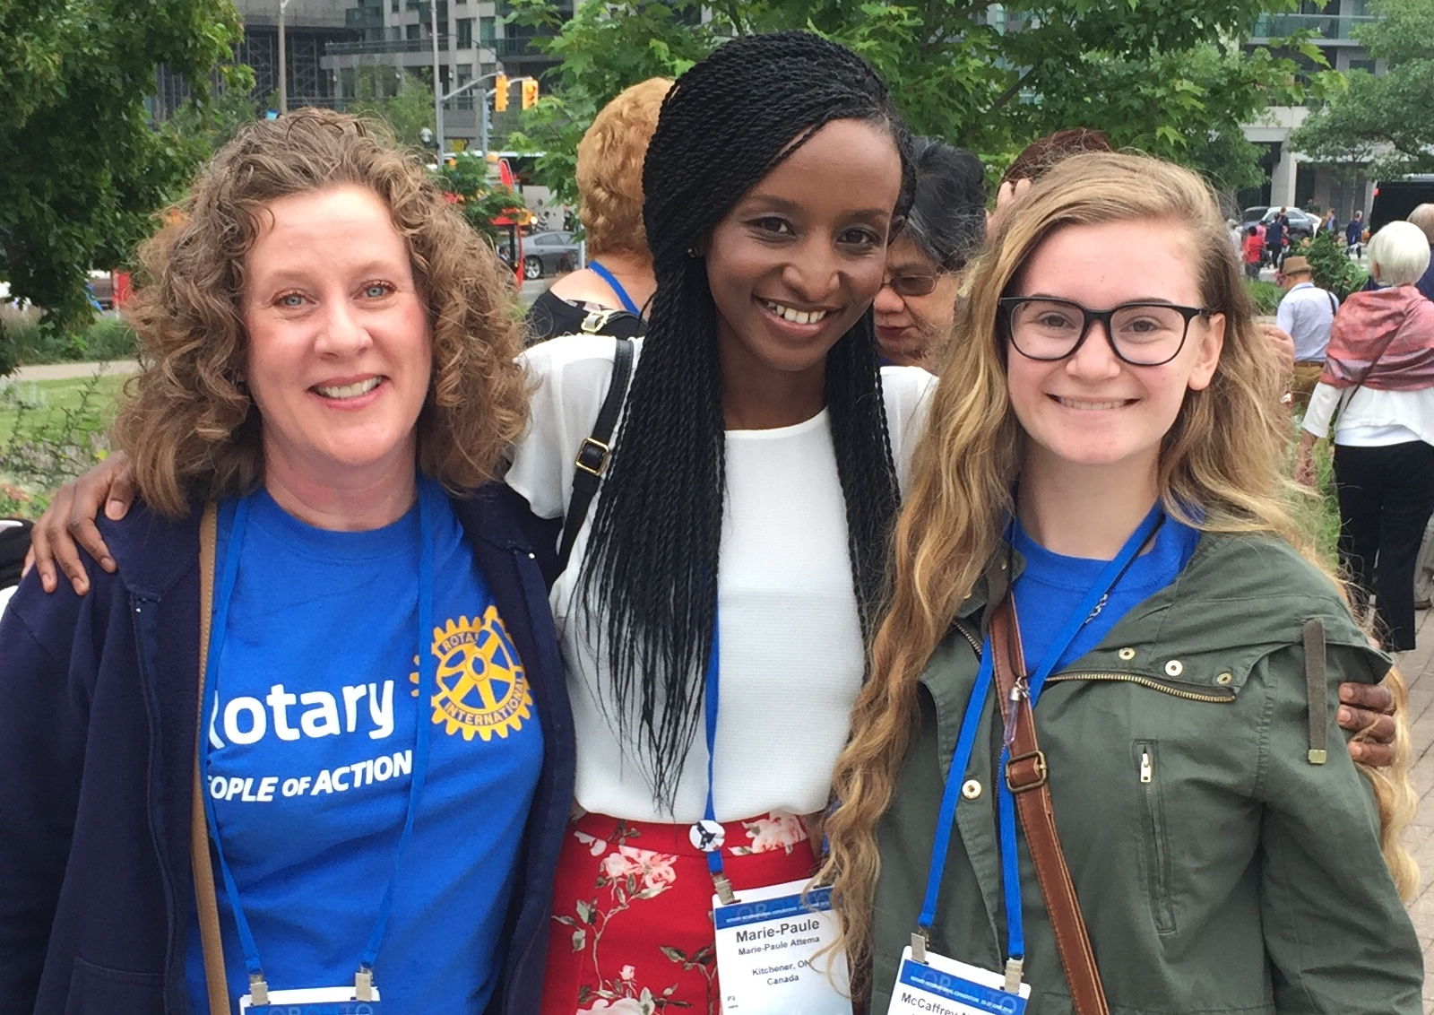
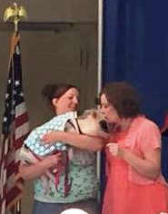

Slide 5
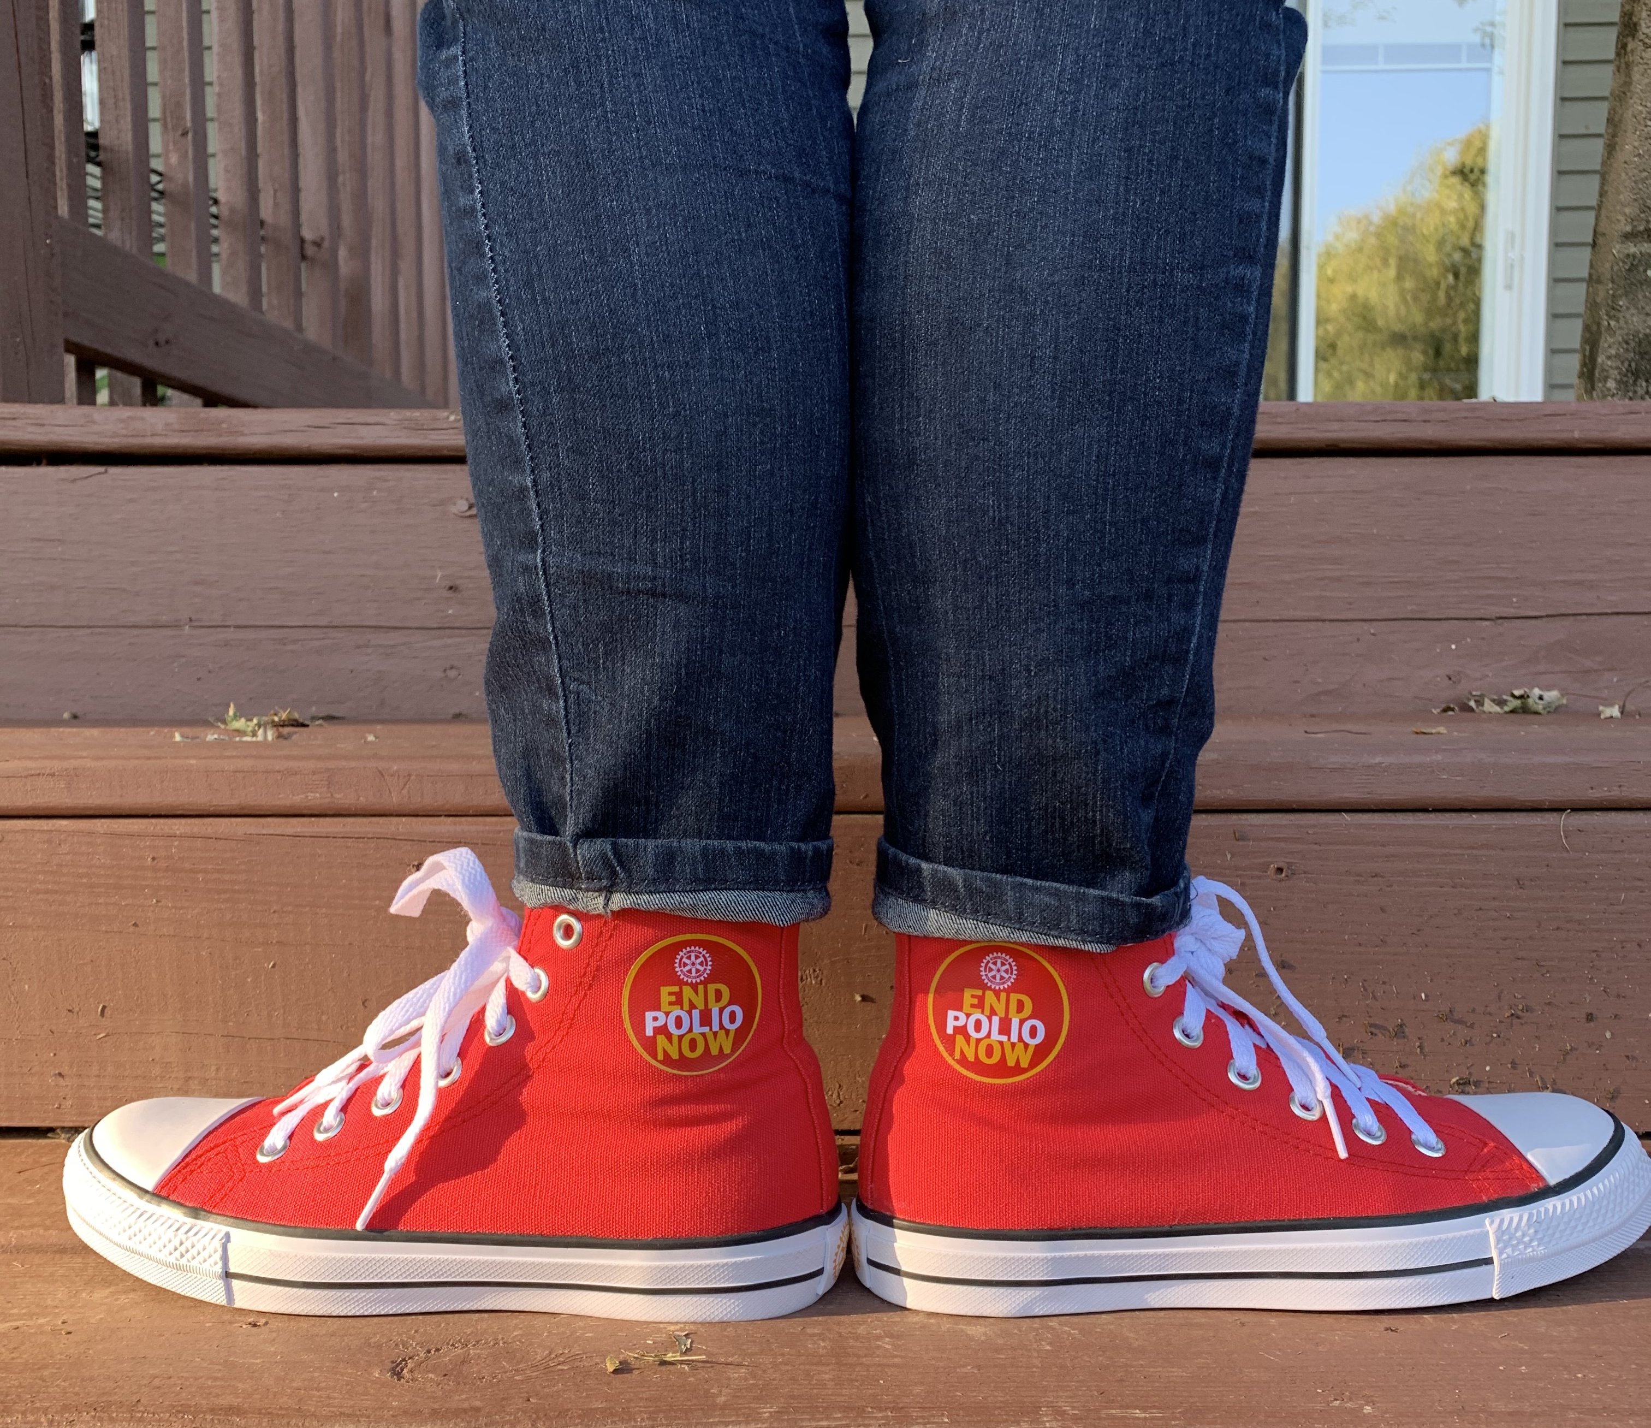
Rotary Leadership Institute
FUN FACTS!

Slide 6
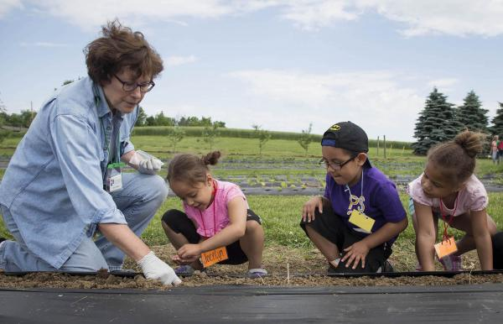
Why RLI?

Slide 7
RLI seeks to provide quality education in Rotary knowledge and leadership skills to Rotarians interested in developing their Rotary participation and to those identified by Rotary Clubs as having a potential in club leadership.

Slide 8
“People don’t buy what you do they buy why you do it.”
Simon Sinek

Slide 9
RLI believes that excellent club leadership is essential to the future of Rotary in a complex and fast changing world.

Slide 10

2023 – 24 Rotary International president Gordon mcinally

Slide 11
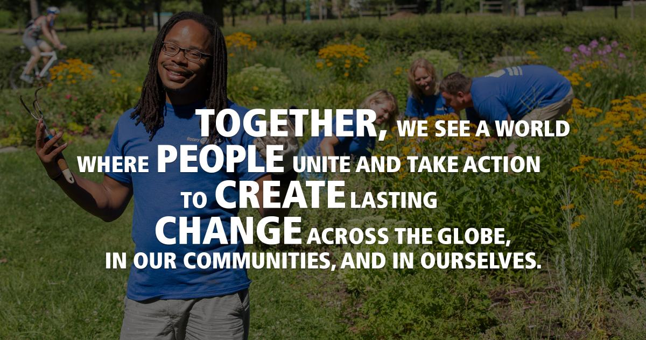
Rotary vision statement
Title Page Option

Slide 12
What is the value proposition of RLI?

Slide 13
Best Practices
Promote RLI using colorful photos & engaging messaging that highlights the value propositions and the WHY; use multiple social media channels, emails, club announcements, personal invitations, testimonials, short videos, scholarships.
Send calendar appointments and reminders to registrants if possible.
Ensure that faculty members are happy, properly trained, engaging, & prepared!
Use current, correctly branded materials including slides, handouts, flip charts. Use one consistent slide deck format for all sessions.
Start with WHY.

Slide 14
Best Practices for Facilitation
Stay focused on the OBJECTIVE.
Ask open ended questions to encourage thoughtful participation.
Use RELAY & RETURN tactics.
Listen & weave.
Value the experience and knowledge in the room.
Keep participants on topic and “manage” the dialogue so it’s not monopolized.
Encourage a “learning journey” approach of which RLI is one part in a constant pursuit of knowledge and understanding.
Encourage use of The Learning Center, the Brand Center, and other RI tools as much as possible.
End with another look at the OBJECTIVE.
End on time.

Slide 15
Evaluation & Feedback
1. Was this content relevant to your current & future leadership in Rotary?
Y/N and Comments:
2. Did you gain new facts or information?
Y/N and Comments:
3. Did you gain any new perspectives or insights?
Y/N and Comments:
4. Did you gain any new materials, resources and/or tools?
Y/N and Comments:
5. Would you recommend RLI to others?
Y/N and Comments:
Best part of the day; suggestions for improvement; faculty knowledge, etc.

Slide 16
Tips for Virtual & Hybrid
Welcome everyone and establish friendly tone. (Request adding club name to their screen name.) *Ask participants to mute their audio unless speaking and enable video.
Stay in “Gallery” view.
Start meeting on time.
Briefly introduce self. Invite brief introductions in first session with cohort.
Always announce zoom protocols & expectations. (chats, raise hands & reactions)
Let people know if recording.
Use slide deck. Highlight the OBJECTIVE.
Quickly Engage Participants with a “raise your hand” type question.
Manage the direction of the content, manage the energy of the room, give clear directions.
Look into the camera, listen into the camera; it’s okay to acknowledge and reference notes.
Utilize MEETING FACILITATOR and PRODUCER roles.
End with the OBJECTIVE. Thank everyone. Reference evaluation. Save Chat. End on time!

Slide 17
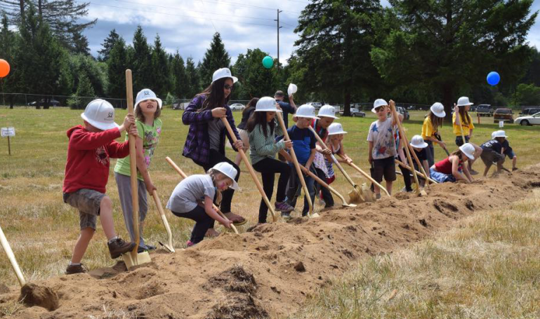
Other learning tools?

Slide 18
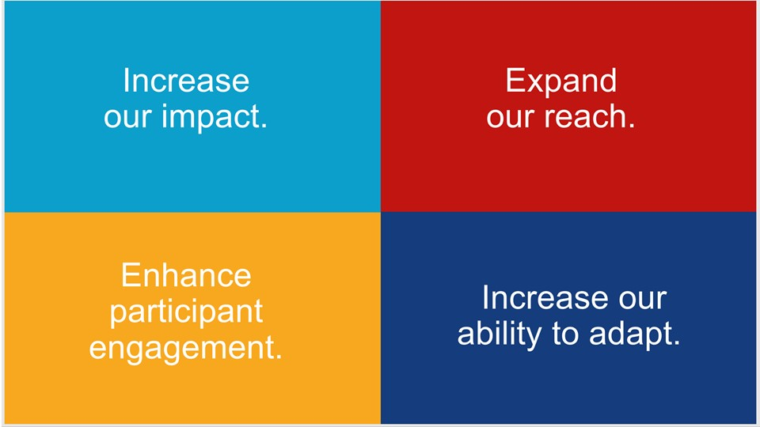

Rotary action plan
Title Page Option

Slide 19
Objective
To inspire and help empower the leadership of RLI-MA with ideas, resources, and tools for continual and increasing success.

Slide 20
If you are not willing to learn, no one can help you. If you are willing to learn, no one
can stop you.
#2023RLI-MA

Slide 21
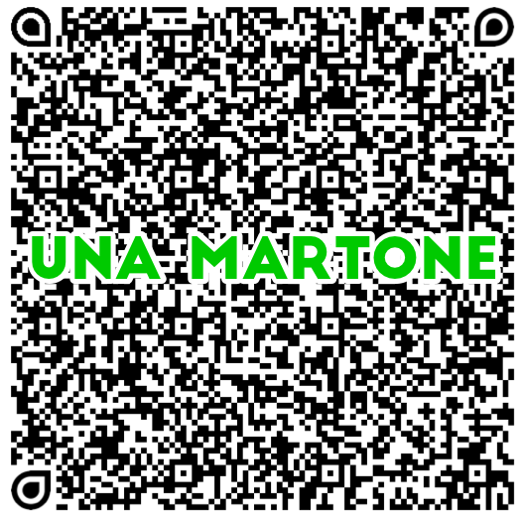
Una Martone
Rotary Club of Harrisburg

